Slide 1
NCFAST Rules Training

Slide 2
Disclaimer
These examples only related to NCFAST and the HCR module. Other modules and projects may be slightly different.

Slide 3
Index
Tags and Syntax
Evidence Data in Rules
Display Rules
Rules Inside the Activation Workflow
Session Docs
Work an Example Defect

Slide 4
Tags and Syntax

Slide 5
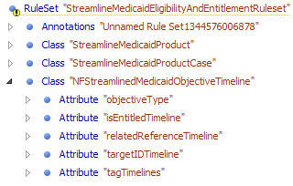
Overall Structure
Rule set > rule class > attribute

Slide 6
All & FixedList
<RuleSet name="Example_all">
<Class name="Person">
<Attribute name="isLoneParent">
<type>
<javaclass name="Boolean"/>
</type>
<derivation>
<all>
<fixedlist>
<listof>
<javaclass name="Boolean"/>
</listof>
<members>
<not>
<reference attribute="isMarried"/>
</not>
<not>
<property name="isEmpty">
<object>
<reference attribute="children"/>
</object>
</property>
</not>
</members>
</fixedlist>
</all>
</derivation>
</Attribute>
Structure
<fixedlist>
<condition 1>
<condition 2>
.
.
.
<condition n>
</fixedlist>
Notes:
<!-- To be considered a "lone parent", a person must
be both unmarried and have at least one child -->
<!-- We happen to know that most people on our
database are married, so we test this condition first.
If it so happens that the isMarried value is not
specified for a Person, then if that Person has
no children then the <all> will return false;
otherwise it will return an error indicating that
the value of isMarried was not specified. -->

Slide 7
All & Dynamic List
<Attribute name="hasNoYoungChildren">
<type>
<javaclass name="Boolean"/>
</type>
<derivation>
<all>
<dynamiclist>
<list>
<reference attribute="children"/>
</list>
<listitemexpression>
<compare comparison="&gt;">
<reference attribute="age">
<current/>
</reference>
<Number value="5"/>
</compare>
</listitemexpression>
</dynamiclist>
</all>
</derivation>
</Attribute>
Structure
<list>
(list to be processed)
</list>
<listitemexpression>
(processing logic)
<listitemexpression>
curam.creole.expression.immediateexceptionreporting
True,error, false - > false || true,error,true - error
A dynamiclist can be used when the number of items in the desired list is not known as design time
Item currently processed
Notes:
If it so happens that one child's age cannot be
calculated, and there is at least one child under 5,
then the <all> will return false; otherwise, it
will return the error showing why the child's age could not be calculated.
-->
<!-- Check whether the children are all over 5 years of age
-->

Slide 8
any
<RuleSet name="Example_any">
<Class name="Person">
<Attribute name="qualifiesForFreeTravelPass">
<type>
<javaclass name="Boolean"/>
</type>
<derivation>
<any>
<fixedlist>
<listof>
<javaclass name="Boolean"/>
</listof>
<members>
<compare comparison="&gt;=">
<reference attribute="age"/>
<Number value="65"/>
</compare>
<reference attribute="isBlind"/>
<reference attribute="isDisabled"/>
</members>
</fixedlist>
</any>
</derivation>
</Attribute>
if a fixed list of three Boolean attributes has these values:
•false;
•<error during calculation>; and
•true
then the calculation of the value of any for these values will return true, because at least one of the items is true (namely the third in the list), regardless of the second item returning an error.
By contrast, if another fixed list of three Boolean attributes has these values:
•false;
•<error during calculation>; and
•false
then the calculation of the value of any for these values will return the error reported by the second item in the list, as this error prevents the determination of whether any items have the value true.
Notes:
Example of <any> operating on a <fixedlist>
To qualify for a free travel pass, the person
must be aged, blind or disabled
We happen to know that most people on our
database are senior citizens, so we test
this condition first.
If it so happens that the isBlind value is not
specified for a Person, then if that Person is
disabled then the <any> will return false;
otherwise it will return an error indicating that
the value of isBlind was not specified.

Slide 9
arithmetic
<Attribute name="addANumberToAnother">
<type>
<javaclass name="Number"/>
</type>
<derivation>
<arithmetic operation="+">
<Number value="3"/>
<Number value="2"/>
</arithmetic>
</derivation>
</Attribute>
<!-- 3 + 2 = 5 -->
<!-- 3 / 2 = 1.5 -->
<!-- (3 + 2) * 4 = 20 -->
<!-- 3 - 2 = 1 -->
<arithmetic operation="*">
<arithmetic operation="+">
<Number value="3"/>
<Number value="2"/>
</arithmetic>
<Number value="4"/>
</arithmetic>
<!-- 1.23 + 3.45 = 4.68, = 4.7 when rounded to the nearest 1 decimal place-->
<arithmetic decimalPlaces="1" operation="+" rounding="half_up">
<!-- 2 / 3, = 0.667 to 3 decimal places -->
<!-- If no rounding is specified,
then a runtime error will occur -->
<!-- 2 / 3, = 0.667 to 3 decimal places -->
<!-- If no rounding is specified,
then a runtime error will occur -->
<arithmetic decimalPlaces="3" operation="/"
rounding="half_up">

Slide 10
Choose/when/otherwise
<Attribute name="ageCategory">
<type>
<javaclass name="String"/>
</type>
<derivation>
<choose>
<type>
<javaclass name="String"/>
</type>
<when>
<condition>
<compare comparison="&lt;">
<reference attribute="age"/>
<Number value="1"/>
</compare>
</condition>
<value>
<String value="Newborn"/>
</value>
</when>
<when>
<condition>
<compare comparison="&lt;">
<reference attribute="age"/>
<Number value="5"/>
</compare>
</condition>
<value>
<String value="Infant"/>
</value>
</when>
<when>
<condition>
<compare comparison="&lt;">
<reference attribute="age"/>
<Number value="18"/>
</compare>
</condition>
<value>
<String value="Child"/>
</value>
</when>
<otherwise>
<value>
<String value="Adult"/>
</value>
</otherwise>
</choose>
</derivation>
</Attribute>
Notes:
There's no explicit <test> clause, so this
<choose> statement will test each condition to
see if it is TRUE.
Note that the order of these conditions is
important; if we were to swap the positions of the
"Newborn" and "Infant" tests, then all children
under 5 (including those under 1) would be
identified as Infants; no children would be
identified as Newborns.

Slide 11
compare
<Class name="CompareExampleRuleClass">
<!-- 3 >= 2 – TRUE -->
<Attribute name="compareTwoNumbers">
<type>
<javaclass name="Boolean"/>
</type>
<derivation>
<compare comparison=">=">
<Number value="3"/>
<Number value="2"/>
</compare>
</derivation>
</Attribute>
<!-- New Year earlier than Christmas - TRUE -->
<Attribute name="compareTwoDates">
<type>
<javaclass name="Boolean"/>
</type>
<derivation>
<compare comparison="&lt;">
<Date value="2007-01-01"/>
<Date value="2007-12-25"/>
</compare>
</derivation>
</Attribute>
</Class>
The comparisons supported are:
<
left hand side "is less than" right hand side;
<=
left hand side "is less than or equal to" right hand side;
>
left hand side "is greater than" right hand side; and
>=
left hand side "is greater than or equal to" right hand side.

Slide 12
sum
<Attribute name="totalAssets">
<type>
<javaclass name="Number"/>
</type>
<derivation>
<!-- Example of <sum> operating on a <dynamiclist> -->
<!-- The total value of a person's assets is derived by
summing the value of each asset -->
<sum>
<dynamiclist>
<list>
<reference attribute="assets"/>
</list>
<listitemexpression>
<reference attribute="value">
<current/>
</reference>
</listitemexpression>
</dynamiclist>
</sum>
</derivation>
</Attribute>

Slide 13
Create
<Class name="Person">
<Attribute name="phoneNumbers">
<type>
<javaclass name="List">
<ruleclass name="PhoneNumber"/>
</javaclass>
</type>
<derivation>
<fixedlist>
<listof>
<ruleclass name="PhoneNumber"/>
</listof>
<members>
<create ruleclass="PhoneNumber">
<this/>
<reference attribute="homePhoneNumber"/>
<specify attribute="areaCode">
<reference attribute="homePhoneAreaCode"/>
</specify>
</create>
<create ruleclass="PhoneNumber">
<this/>
<reference attribute="workPhoneNumber"/>
<specify attribute="areaCode">
<reference attribute="workPhoneAreaCode"/>
</specify>
</create>
</members>
</fixedlist>
</derivation>
</Attribute>
</Class>
<Class name="PhoneNumber">
<Initialization>
<Attribute name="owner">
<type>
<ruleclass name="Person"/>
</type>
</Attribute>
<Attribute name="number">
<type>
<javaclass name="Number"/>
</type>
</Attribute>
</Initialization>
<Attribute name="areaCode">
<type>
<javaclass name="Number"/>
</type>
<derivation>
<Number value="123"/>
</derivation>
</Attribute>
</Class>

Slide 14
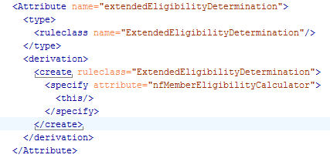
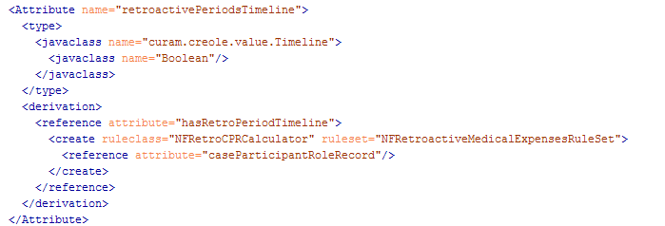
Create (Cont.)
When the rule class is in the current rule set.
When the rule class is NOT in the current rule set, add the ruleset.

Slide 15
Date
<RuleSet name="Example_Date">
<Class name="DateExampleRuleClass">
<Attribute name="nullDate">
<type>
<javaclass name="curam.util.type.Date"/>
</type>
<derivation>
<!-- A null Date -->
<null/>
</derivation>
</Attribute>
<Attribute name="dateOfBirth">
<type>
<javaclass name="curam.util.type.Date"/>
</type>
<derivation>
<!-- The Date 3rd October, 1970 -->
<Date value="1970-10-03"/>
</derivation>
</Attribute>
</Class>
</RuleSet>
The Date 's value is specified in the form yyyy-mm-dd.

Slide 16
equals
Determines whether two objects are equal.
<!-- TRUE -->
<derivation>
<equals>
<String value="A String"/>
<String value="A String"/>
</equals>
</derivation>
<!-- FALSE -->
<derivation>
<equals>
<String value="A String"/>
<String value="A different String"/>
</equals>
</derivation>
<!-- TRUE -->
<derivation>
<equals>
<!-- These numbers are the same,
disregarding trivial
differences in leading/trailing
zeroes -->
<Number value="123"/>
<Number value="000123.000"/>
</equals>
</derivation>
<!-- FALSE -->
<derivation>
<equals>
<!-- These objects are of
different types, so are
not equal even if they
"look" the same.-->
<String value="123"/>
<Number value="123"/>
</equals>
</derivation>
<!-- FALSE -->
<derivation>
<equals>
<null/>
<Number value="456"/>
</equals>
</derivation>
<!-- TRUE -->
<derivation>
<equals>
<null/>
<null/>
</equals>
</derivation>

Slide 17
existencetimeline
<Attribute name="isAliveTimeline">
<type>
<javaclass name="curam.creole.value.Timeline">
<javaclass name="Boolean"/>
</javaclass>
</type>
<derivation>
<existencetimeline>
<intervaltype>
<javaclass name="Boolean"/>
</intervaltype>
<intervalfromdate>
<reference attribute="dateOfBirth"/>
</intervalfromdate>
<intervaltodate>
<reference attribute="dateOfDeath"/>
</intervaltodate>
<preExistenceValue>
<false/>
</preExistenceValue>
<existenceValue>
<true/>
</existenceValue>
<postExistenceValue>
<false/>
</postExistenceValue>
</existencetimeline>
</derivation>
</Attribute>
<Attribute name="lifeStatus">
<type>
<javaclass name="curam.creole.value.Timeline">
<javaclass name="String"/>
</javaclass>
</type>
<derivation>
<existencetimeline>
<intervaltype>
<javaclass name="String"/>
</intervaltype>
<intervalfromdate>
<reference attribute="dateOfBirth"/>
</intervalfromdate>
<intervaltodate>
<reference attribute="dateOfDeath"/>
</intervaltodate>
<preExistenceValue>
<String value="Before Birth"/>
</preExistenceValue>
<existenceValue>
<String value="During Lifetime"/>
</existenceValue>
<postExistenceValue>
<String value="After Death"/>
</postExistenceValue>
</existencetimeline>
</derivation>
</Attribute>

Slide 18
filter
<!-- All the lone parents in the household -->
<Attribute name="loneParents">
<type>
<javaclass name="List">
<ruleclass name="Person"/>
</javaclass>
</type>
<derivation>
<filter>
<list>
<reference attribute="members"/>
</list>
<listitemexpression>
<all>
<fixedlist>
<listof>
<javaclass name="Boolean"/>
</listof>
<members>
<!-- No spouse -->
<equals>
<reference attribute="spouse">
<current/>
</reference>
<null/>
</equals>
<!-- At least one child -->
<not>
<property name="isEmpty">
<object>
<reference attribute="children">
<current/>
</reference>
</object>
</property>
</not>
</members>
</fixedlist>
</all>
</listitemexpression>
</filter>
</derivation>
</Attribute>

Slide 19
Timelineoperation, intervalvalue
<!--
The person qualified for benefit if (on any particular day)
the person is alive and the total value of the person's assets
does not exceed the maximum asset threshold.
-->
<Attribute name="qualifiesForBenefitTimeline">
<type>
<javaclass name="curam.creole.value.Timeline">
<javaclass name="Boolean"/>
</javaclass>
</type>
<derivation>
<timelineoperation>
<all>
<fixedlist>
<listof>
<javaclass name="Boolean"/>
</listof>
<members>
<!--
operate on the Timelines as if they were primitive
values
-->
<intervalvalue>
<reference attribute="isAliveTimeline"/>
</intervalvalue>
<compare comparison="&lt;=">
<intervalvalue>
<reference attribute="totalAssetValueTimeline"/>
</intervalvalue>
<intervalvalue>
<reference attribute="maximumAssetsThreshold"/>
</intervalvalue>
</compare>
</members>
</fixedlist>
</all>
</timelineoperation>
</derivation>
</Attribute>

Slide 20
joinlists
<Class name="Person">
<Attribute name="pets">
</Attribute>
</Class>
<Class name="Pet">
<Initialization>
<Attribute name="name">
</Attribute>
</Initialization>
</Class>
<Class name="Household">
<Attribute name="members">
<type>
<javaclass name="List">
<ruleclass name="Person"/>
</javaclass>
</type>
<derivation>
<specified/>
</derivation>
</Attribute>
<!-- get all the pets in the household, by joining together each person's
list of pets -->
<Attribute name="allPets">
<type>
<javaclass name="List">
<ruleclass name="Pet"/>
</javaclass>
</type>
<derivation>
<joinlists>
<!-- a list of list of pets, one list for each household member -->
<dynamiclist>
<list>
<reference attribute="members"/>
</list>
<listitemexpression>
<reference attribute="pets">
<current/>
</reference>
</listitemexpression>
</dynamiclist>
</joinlists>
</derivation>
</Attribute>
</Class>

Slide 21
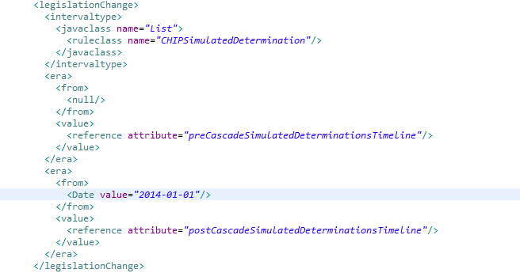
Legislationchange/era

Slide 22
Max/min
max
<Attribute name="largestNumberOfSpots">
<type>
<javaclass name="Number"/>
</type>
<derivation>
<max>
<dynamiclist>
<list>
<reference attribute="dalmatians"/>
</list>
<listitemexpression>
<reference attribute="numberOfSpots">
<current/>
</reference>
</listitemexpression>
</dynamiclist>
</max>
</derivation>
</Attribute>
min
<Attribute name="eariestDate">
<type>
<javaclass name="curam.util.type.Date"/>
</type>
<derivation>
<min>
<reference attribute="publicHolidays"/>
</min>
</derivation>
</Attribute>
<Attribute name="publicHolidays">
<type>
<javaclass name="List">
<javaclass name="curam.util.type.Date"/>
</javaclass>
</type>
<derivation>
<fixedlist>
<listof>
<javaclass name="curam.util.type.Date"/>
</listof>
<members>
<Date value="2007-01-01"/>
<Date value="2007-12-25"/>
</members>
</fixedlist>
</derivation>
</Attribute>

Slide 23
Not
<Attribute name="isLivingInUSA">
<type>
<javaclass name="Boolean"/>
</type>
<derivation>
<!-- Note that this not-within-not is somewhat contrived. -->
<not>
<reference attribute="isLivingOutsideUSA"/>
</not>
</derivation>
</Attribute>
<Attribute name="isLivingOutsideUSA">
<type>
<javaclass name="Boolean"/>
</type>
<derivation>
<not>
<equals>
<reference attribute="country"/>
<String value="USA"/>
</equals>
</not>
</derivation>
</Attribute>

Slide 24
null
<Attribute name="favoritePetsName">
<type>
<javaclass name="String"/>
</type>
<derivation>
<choose>
<type>
<javaclass name="String"/>
</type>
<when>
<!-- if this Person has no
favorite pet, then calculate the
name of the favorite pet as null. -->
<condition>
<equals>
<reference attribute="favoritePet"/>
<null/>
</equals>
</condition>
<value>
<null/>
</value>
</when>
<otherwise>
<value>
<!-- get the name of the favorite pet -->
<reference attribute="name">
<reference attribute="favoritePet"/>
</reference>
</value>
</otherwise>
</choose>
</derivation>
</Attribute>
<!-- The name of this Person's favorite Pet, or null if the Person owns no pet. We have to test for the favoritePet being null before performing the (simple) calculation.-->

Slide 25
property
<Class name="Person">
<Attribute name="isMinor">
<type>
<javaclass name="curam.creole.value.Timeline">
<ruleclass name="Boolean"/>
</javaclass>
</type>
<derivation>
<specified/>
</derivation>
</Attribute>
<!-- Whether this person is a child. -->
<Attribute name="isAChild">
<type>
<javaclass name="Boolean"/>
</type>
<derivation>
<property name="valueOn">
<object>
<reference attribute="isMinor"/>
</object>
<arguments>
<Date value="2000-01-01"/>
</arguments>
</property>
</derivation>
</Attribute>
<Attribute name="secondAndSubsequentChildren">
<type>
<javaclass name="List">
<ruleclass name="Person"/>
</javaclass>
</type>
<derivation>
<property name="subList">
<object>
<reference attribute="children"/>
</object>
<arguments>
<!-- The number must be converted to an integer
(as required by List.subList). -->
<property name="intValue">
<object>
<Number value="1"/>
</object>
</property>
<property name="size">
<object>
<reference attribute="children"/>
</object>
</property>
</arguments>
</property>
</derivation>
</Attribute>

Slide 26
Readall/match/Codetable
Retrieves the person's benefits of type "IncomeAssistance",
using a <match> to retrieve all the person's benefits, and then
a <filter> to extract only the "Income Assistance" benefits from
the benefits for that person.
This implementation may be suitable when the
socialSecurityNumber is the most selective attribute for a
Benefit in the data storage (i.e. there are many Benefit rule
objects, but each socialSecurityNumber value is present on
relatively few Benefit rule objects).
<Attribute name="incomeAssistanceBenefitsMatchSSNFilterType">
<type>
<javaclass name="List">
<ruleclass name="Benefit"/>
</javaclass>
</type>
<derivation>
<filter>
<list>
<!-- retrieve all Benefit rule objects for the Person
-->
<readall ruleclass="Benefit">
<match retrievedattribute="socialSecurityNumber">
<reference attribute="socialSecurityNumber"/>
</match>
</readall>
</list>
<listitemexpression>
<equals>
<!-- filter the Benefit rule objects for the Person
down to those of type "Income Assistance" only
-->
<reference attribute="type">
<current/>
</reference>
<Code table="BenefitType">
<!-- The value for Income Assistance -->
<String value="BT1"/>
</Code>
</equals>
</listitemexpression>
</filter>
</derivation>
</Attribute>

Slide 27
Removeduplicates
<Attribute name="uniqueRelatives">
<type>
<javaclass name="List">
<ruleclass name="Person"/>
</javaclass>
</type>
<derivation>
<removeduplicates>
<reference attribute="allRelatives"/>
</removeduplicates>
</derivation>
</Attribute>
<Attribute name="allRelatives">
<type>
<javaclass name="List">
<ruleclass name="Person"/>
</javaclass>
</type>
<derivation>
<!-- get the relatives of this person by forming a
list of the "toPerson" on the other end of each
relationship. -->
<dynamiclist>
<list>
<reference attribute="relationships"/>
</list>
<listitemexpression>
<reference attribute="toPerson">
<current/>
</reference>
</listitemexpression>
</dynamiclist>
</derivation>
</Attribute>

Slide 28
ResourceMessage
<!-- Returns a greeting which contains
the person's title and surname.
The greeting and title are localized,
the surname is not (it is identical
in all locales). -->
<Attribute name="parameterizedGreetingMessage">
<type>
<javaclass name="curam.creole.value.Message"/>
</type>
<derivation>
<!-- pass in arguments to
the message placeholders -->
<ResourceMessage key="parameterizedGreeting"
resourceBundle="curam.creole.example.Messages">
<!-- Title -->
<choose>
<type>
<javaclass name="curam.creole.value.Message"/>
</type>
<when>
<condition>
<equals>
<reference attribute="gender"/>
<String value="Male"/>
</equals>
</condition>
<value>
<ResourceMessage key="title.male"
resourceBundle="curam.creole.example.Messages"/>
</value>
</when>
<when>
<condition>
<reference attribute="isMarried"/>
</condition>
<value>
<ResourceMessage key="title.female.married"
resourceBundle="curam.creole.example.Messages"/>
</value>
</when>
<otherwise>
<value>
<ResourceMessage key="title.female.single"
resourceBundle="curam.creole.example.Messages"/>
</value>
</otherwise>
</choose>
<!-- Surname -->
<reference attribute="surname"/>
</ResourceMessage>
</derivation>
</Attribute>
curam.creole.example.Messages is a properties file

Slide 29
Sort/singleitem
<!-- The first child born to this person -->
<Attribute name="firstBornChild">
<type>
<ruleclass name="Person"/>
</type>
<derivation>
<!-- get the first child, if any
- if no children, return null -->
<singleitem onEmpty="returnNull" onMultiple="returnFirst">
<!-- sort the children in date-of-birth order -->
<sort>
<list alias="child">
<reference attribute="children"/>
</list>
<sortorder>
<sortitem direction="ascending">
<reference attribute="dateOfBirth">
<current alias="child"/>
</reference>
</sortitem>
</sortorder>
</sort>
</singleitem>
</derivation>
</Attribute>
onEmpty-> returnNull,error onmultiple->returnNull, returnFirst, returnLast, error

Slide 30
XmlMessage
<Class name="XmlMessageExampleRuleClass">
<Attribute name="emptyMessage">
<type>
<javaclass name="curam.creole.value.Message"/>
</type>
<derivation>
<!-- contains no XML at all -->
<XmlMessage/>
</derivation>
</Attribute>
<Attribute name="simpleHtmlMessage">
<type>
<javaclass name="curam.creole.value.Message"/>
</type>
<derivation>
<!-- Using XmlMessage can ensure that
XML elements are started and
ended correctly, e.g. <b> and </b> -->
<XmlMessage>The following text will appear in bold in a
browser: <b>Some in bold text.</b>
</XmlMessage>
</derivation>
</Attribute>
<Attribute name="tokenReplacementHtmlMessage">
<type>
<javaclass name="curam.creole.value.Message"/>
</type>
<derivation>
<XmlMessage><p/>This calculated number will appear in
italics and formatted according to locale preferences:<i>
<replace>
<arithmetic operation="+">
<Number value="1.23"/>
<Number value="3.45"/>
</arithmetic>
</replace>
</i>
<p/>And here's a resource message: <replace>
<ResourceMessage key="simpleGreeting"
resourceBundle="curam.creole.example.Messages"/>
</replace>
</XmlMessage>
</derivation>
</Attribute>
</Class>

Slide 31
specified
<Attribute name="name">
<type>
<javaclass name="String"/>
</type>
<derivation>
<specified/>
</derivation>
</Attribute>
Notes:
Add(String…)

Slide 32
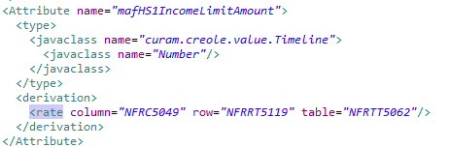
Rate table
Rate tables are used rather than hard-coded values in rule sets
Here the table value NFRTT5062 is from CT_RateTableType.ctx – specifies which rate table, row value ‘ NFRTT5119 ' is from CT_RateRowType.ctx and column value ' NFRTT5049' CT_RateColumnType.ctx.
Table Column Attribute
RateHeader -> RateHeaderID -> (RateTableType NFRTT5062)
RateRow -> RateRowID -> (RateRowType NFRRT5119 & RateHeaderID)
RateColumn -> RateColumnID -> (RateColumnType NFRC5049 & RateHeaderID)
RateCell -> RateRowID +RateColumnID => Value for that rate element in the above derivation

Slide 33
call
<Class Person>
<Attribute name="favoriteColor">
<type>
<javaclass name="String"/>
</type>
<derivation>
<!-- Call a java static method
to perform the calculation -->
<call class="curam.creole.example.Statics"
method="calculateFavoriteColor">
<type>
<javaclass name="String"/>
</type>
<arguments>
<!-- Pass in this person
as an argument to the
static method -->
<this/>
</arguments>
</call>
</derivation>
</Attribute>
</Class>
public class Statics {
public static String calculateFavoriteColor(
final Session session, final RuleObject person) {
final String name =
(String) person.getAttributeValue("name").getValue();
final Number age =
(Number) person.getAttributeValue("age").getValue();
final String ageString = age.toString();
if (ageString.contains("5") || ageString.contains("7")) {
return "Blue";
} else if (name.contains("z")) {
return "Purple";
} else {
return "Green";
}
}
}

Slide 34
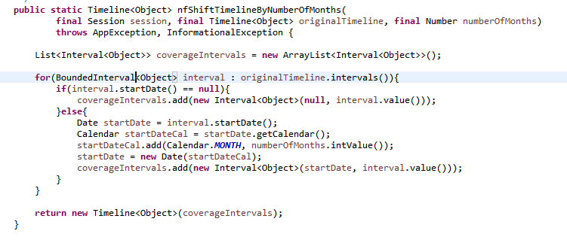
Statics Calls
Most common call is to an OOTB Statics.class or the custom NFStatics.java.
Several OOTB Statics classes so be careful with the call path.

Slide 35
Evidence Data in Rules

Slide 36
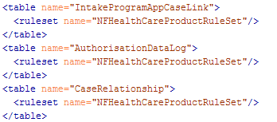
Evidence or DB Table Propagator
StandardEntityProgagatorConfiguration.xml
Link between database and rules.

Slide 37
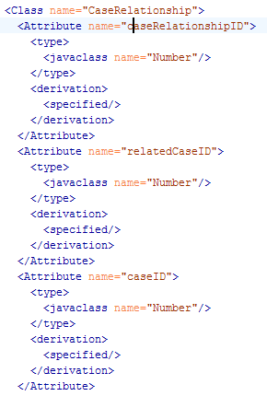
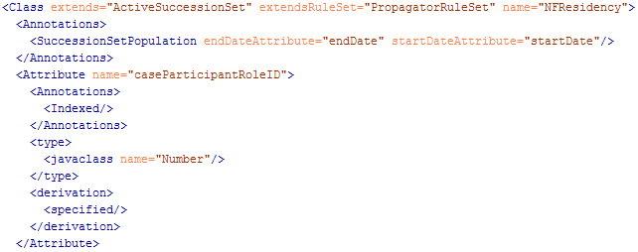
Converting to Rules Object
NFHealthCareProductRuleSet.xml
DB Table
Evidence

Slide 38
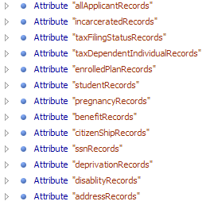
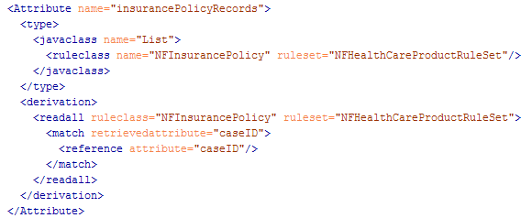
Where Evidence is Used
HealthCareRuleSet.xml
InsuranceAffordabilityIntegratedCase ruleclass

Slide 39
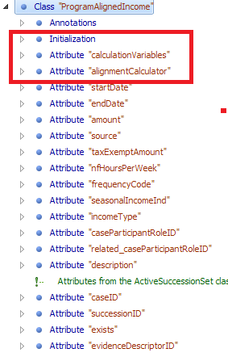
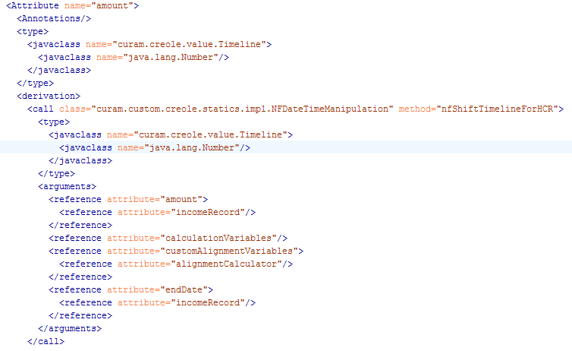
Evidence Rules Object Alignment
NFHealthCareProductRuleSet.xml

Slide 40
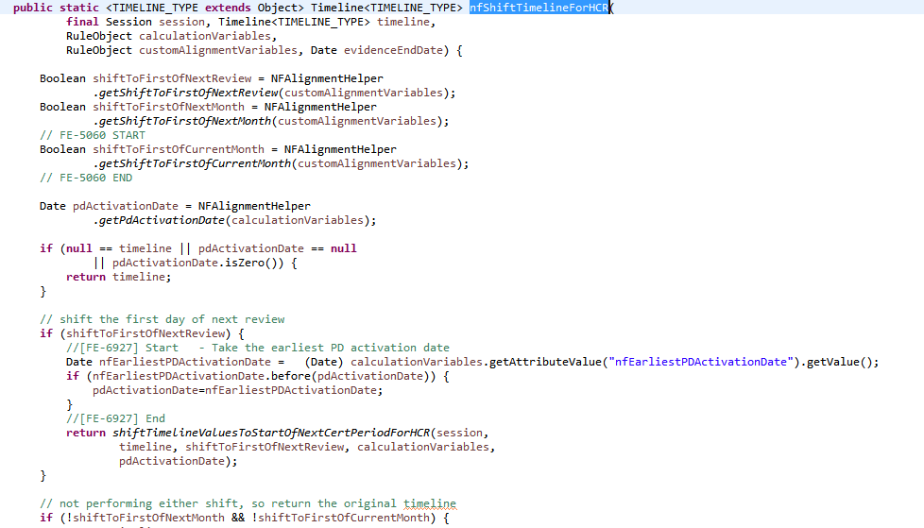
Alignment Java
NFDateTimeManipulation.java

Slide 41
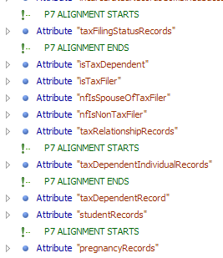
Where Alignment is Used
HealthCareRuleSet.xml
MemberCPRCalculator ruleclass

Slide 42
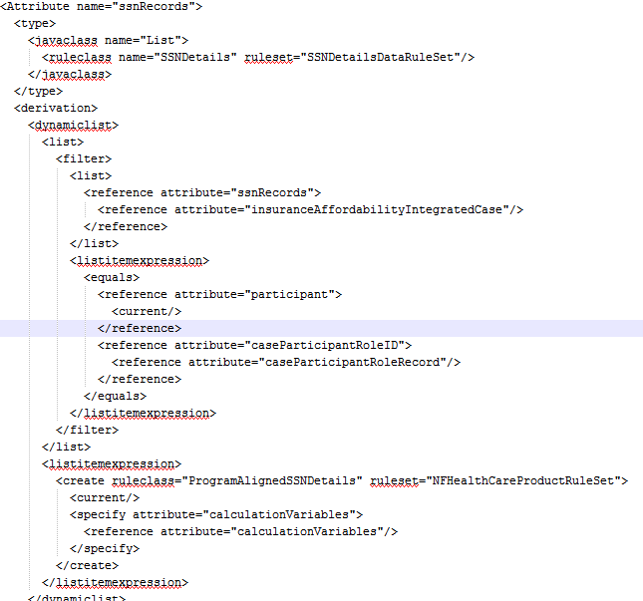
Where Alignment is Used (cont.)

Slide 43
Display Rules

Slide 44
Structure
XML rules files
DMX files
Database blob
UIM, properties, and config files

Slide 45
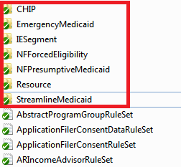
XML Rules Files
Display rules are stored in the folders at the top of the rules folder.
This is the customHCR\CREOLE_Rule_Sets folder

Slide 46
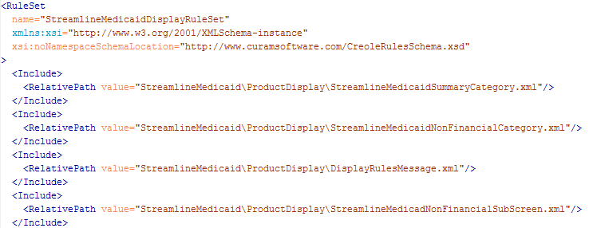
XML Rules Files (Cont.)
2 types of display rules xml files: parent and child.
Parent is the rule set declaration and has the links to all the child files.

Slide 47
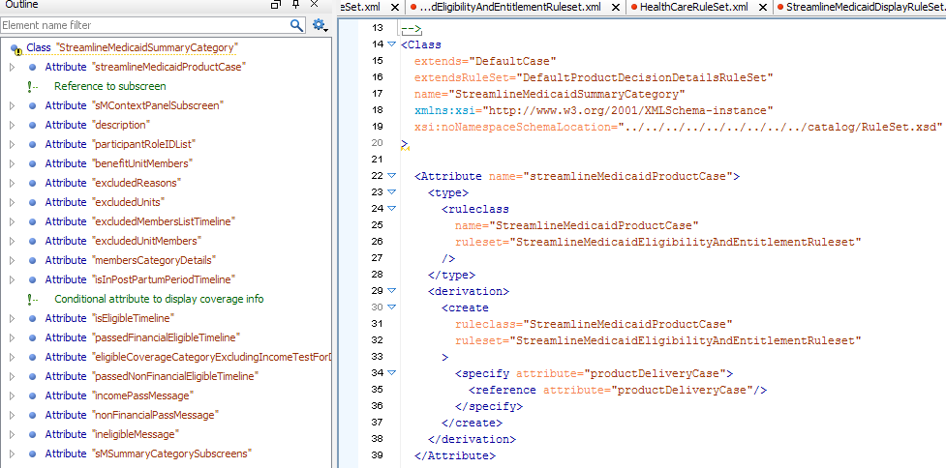
XML Rules Files (Cont.)
Child is the rule class declaration and looks similar to the eligibility rules files.

Slide 48
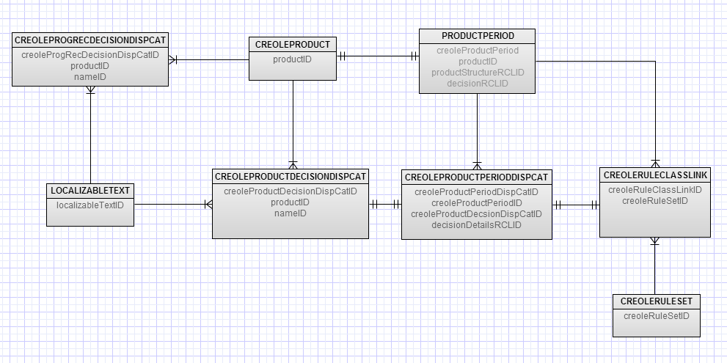
DMX Files
Located in custom\data\initial
Create links between rule sets, classes, and used to trigger rules in some java.

Slide 49
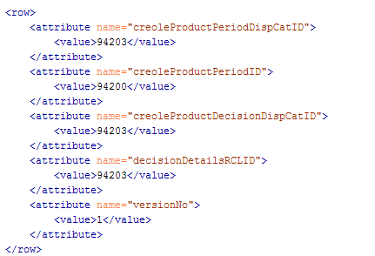
DMX Files (Cont.)
Some files are just links between other dmx files, like CreoleProductPeriodDisCat.dmx.

Slide 50
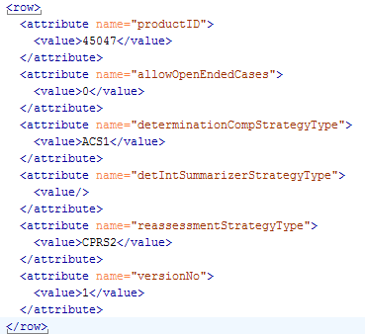
DMX Files (Cont.)
Some files create the new product type, like CreoleProduct.dmx.

Slide 51
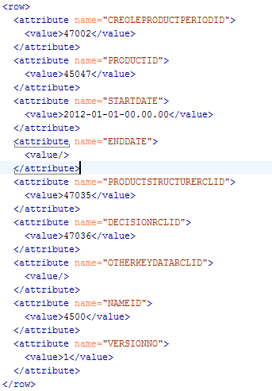
DMX Files (Cont.)
Some files declare the configuration of the product, like CreoleProductPeriod.dmx.

Slide 52
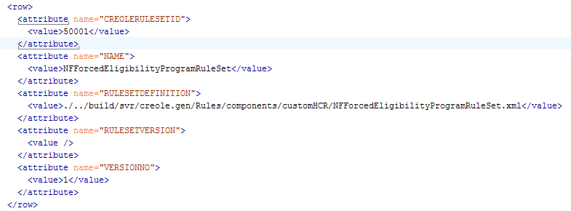
DMX Files (Cont.)
Some files link the product to the rules xml files, like CreoleRuleSet.dmx.

Slide 53
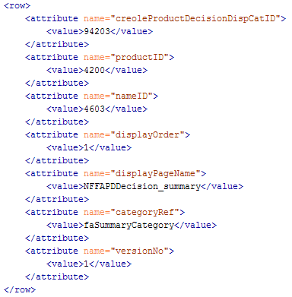
DMX Files (Cont.)
Some files link the product to the display rules, like CreoleProductDecisionDisCat.dmx.

Slide 54

Database Blob
There are several tables that store rules blobs: CreoleCaseDeterminationData, AppCaseEligibilityResultData, etc.
The structure varies, but the value you are looking for is the blob.

Slide 55
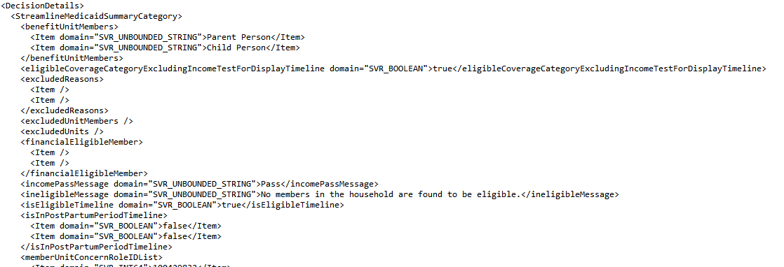
Database Blob (Cont.)
The blob is a compressed data type that stores the returns (display rules) of an assessment.
We can parse the blob to make it readable as XML format text, XMLReader.java can do this.

Slide 56
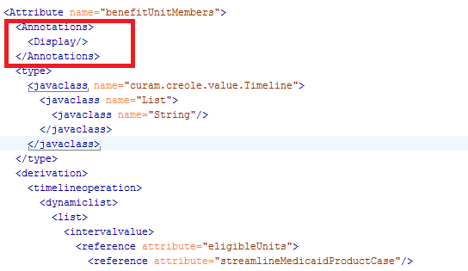
Database Blob (Cont.)
To have a display rules attribute show up in the blob, you MUST have a display annotation.

Slide 57
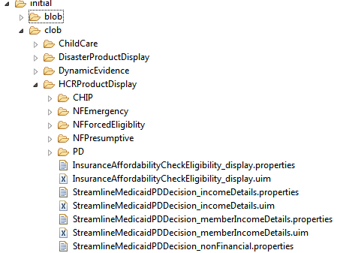
UIM’s, Properties, and Config
UIM/Property files are stored in the server folders instead of the client like normal uim’s.
Located in custom\data\initial\clob

Slide 58
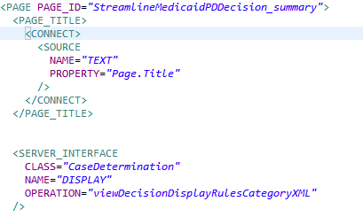
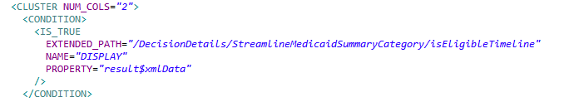
UIM’s, Properties, and Config (Cont.)
The only difference from normal uim files is that display rules use xpath and need to be declared in the AppResource.dmx.

Slide 59
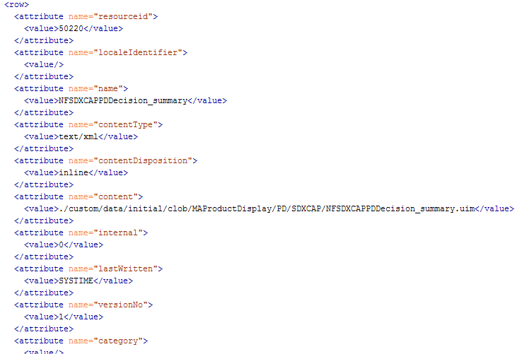
UIM’s, Properties, and Config (Cont.)
AppResource.dmx

Slide 60
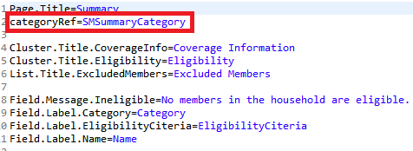
UIM’s, Properties, and Config (Cont.)
The only difference from normal properties files is the inclusion of a categoryRef, which refers back to the DMX files, and need to be declared in the AppResource.dmx.

Slide 61
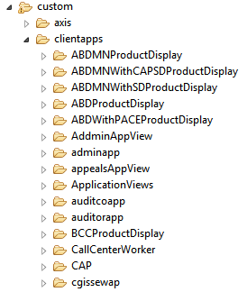
UIM’s, Properties, and Config (Cont.)
Display rule nav files are the same as normal nav file, just located in the server folder, custom/clientapps.

Slide 62
Rules Inside the Activation Workflow

Slide 63
Rules Inside the Activation Workflow
Rule Triggers:
Eligibility check
Case activation
Apply evidence changes to an active case
Manual reassessment
Recertification
Batch
OOTB secondary assessment after accepting a decision or case activation

Slide 64
Rules Inside the Activation Workflow (Cont.)
User driven workflow
Application Case
Integrated
Case
Check Eligibility
Program Eligibility Check
Secondary Assessment after Activation
Product Delivery
Case

Slide 65
Rules Inside the Activation Workflow (Cont.)
Post activation workflow
PDC level rules run
Denorm table updated
IE segment table updated
CC segment table updated
Individual cert table updated
Aligned Denorm table updated
Exit out
PD cert table updated
Case header table updated
Secondary Assessment

Slide 66
Session Docs

Slide 67
What is a Session Doc?
Primary debugging tool for rules.
Nearly impossible to debug rules without one.
It is a set of files that are interconnected to create a map of the rules objects, their values, and links from the given assessment.

Slide 68
Create a Session Doc
2 different ways to dump a rules session: command line and junit.
Command line uses a blob in the database to create a session doc for that specific assessment.
Junit uses the caseID to run a real time reassessment of the case.

Slide 69
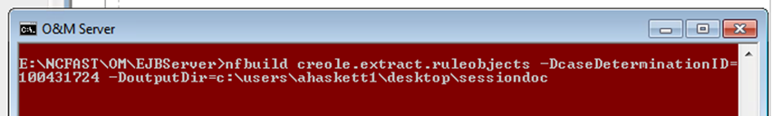
Create a Session Doc (Cont.)
Command line: nfbuild creole.extract.ruleobjects -DcaseDeterminationID = <creolecasedeterminationID> -DoutputDir = <file path>.
ID for the session dump
CDAS1 is the current assessment
ID for blob the command line parses
ID for blob the display rules use

Slide 70
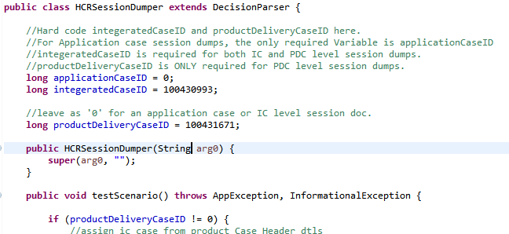
Create a Session Doc (Cont.)
Junit: HCRSessionDumper.java, others for P26.
Enter caseID’s for the appropriate case level then run as a junit.

Slide 71
Command line vs Junit
The command line method is less detailed since it is coming from a blob. The junit method runs a reassessment and captures all attribute values.
Junit can only be used in your local, does not work for prod staging and debug schemas.
Command line cannot be used if there is an unhandled server exception in the rules.
Junit method needs to be ran strategically due to database records being created at various stages of the workflow.

Slide 72
Command line vs Junit (Cont.)
For the command line method, the session doc is created in the specificed –DoutputDir.
For the junit method, the session doc is created in the server build folder build/tests/RulesSessionDoc/.

Slide 73
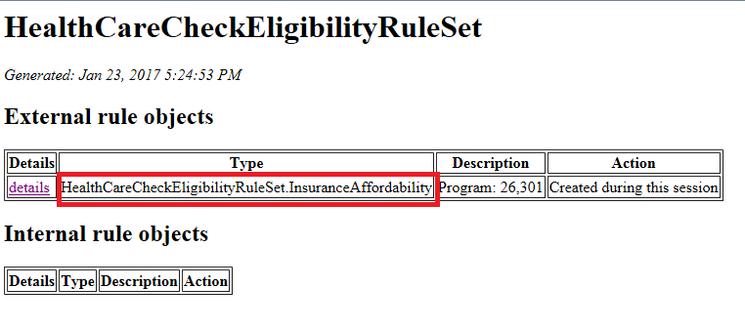
Where to start on a Session Doc
Applcation case: HealthCareCheckEligibilityRuleSet.

Slide 74
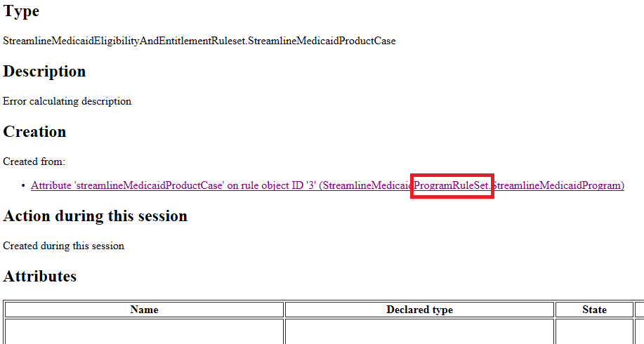
Where to start on a Session Doc (Cont.)
Integrated case: ProductCase of the program causing the issue AND created from the Program rule set.

Slide 75
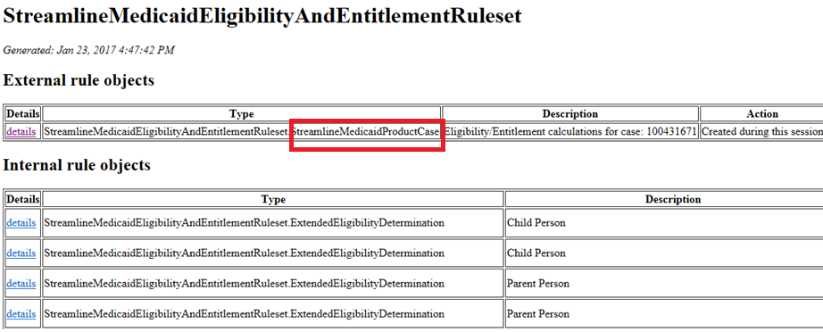
Where to start on a Session Doc (Cont.)
Product delivery case – eligibility rules : ProductCase of the program causing the issue.

Slide 76
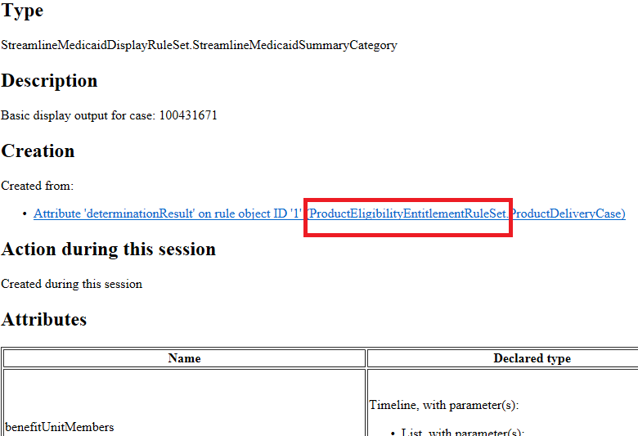
Where to start on a Session Doc (Cont.)
Product delivery case –display rules : the screen that is causing the error AND created from the ProductEligiibilityEntitlementRuleSet.

Slide 77
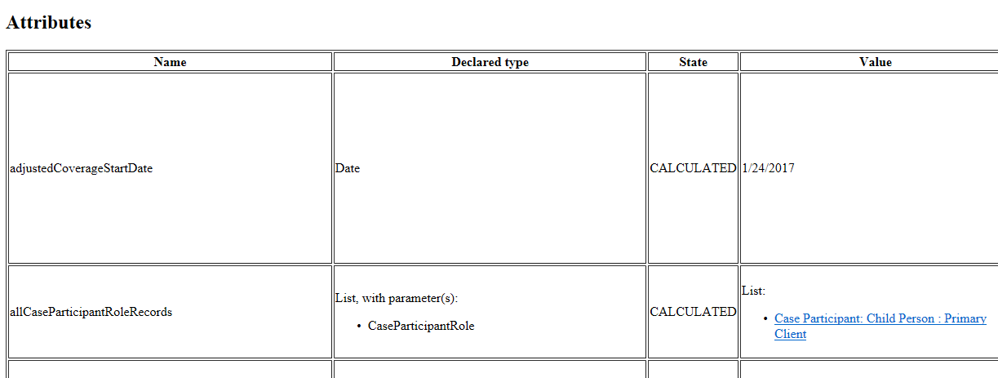
How to Read a Session Doc
Calculated
or
Specified
Name of attribute
Return type of attribute
Return value of attribute

Slide 78
How to Read a Session Doc (Cont.)
Attribute status:
Calculated - the logic that shows in the session doc is what created the return value.
Specified – the logic that shows in the session doc has been overwritten and the return value is from the class that created the current class.
Error – there is an error somewhere in this attribute’s logic or in the attributes this one uses.
Not_Yet_Calculated – attribute was not in the blob for the command line session dump to pick up.

Slide 79
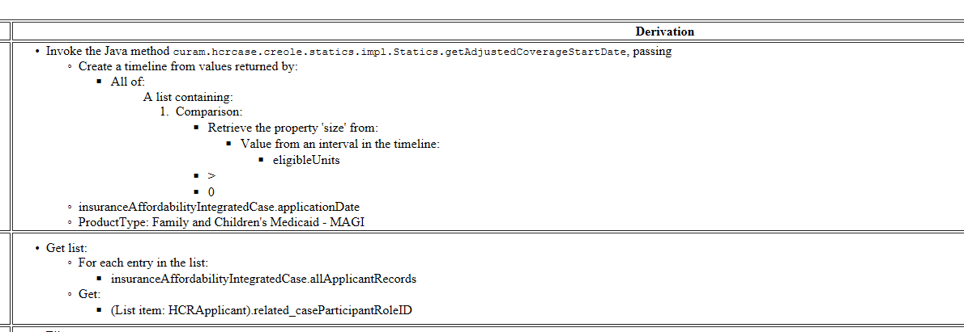
How to Read a Session Doc (Cont.)
Logic of the attribute, what is coded in the <derivation> part of the xml.

Slide 80
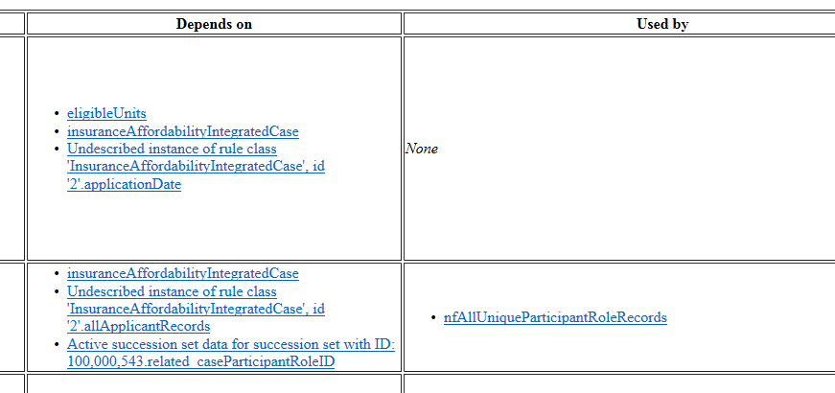
How to Read a Session Doc (Cont.)
The attributes used in the derivation
The attributes that use this attribute

Slide 81
Sample Session Doc
In sharepoint: P7 example session doc

Slide 82
Work an Example Defect

Slide 83
Scenario
FE-3089: Display Rules – MPW coverage category displays as ‘Pregnant’ instead of ‘Pregnant Woman’.
Standard Pregnancy PDC, $100 income.
The member coverage category on the summary tab has the wrong value.
FD says the coverage category name should be ‘Pregnant Woman’.

Slide 84
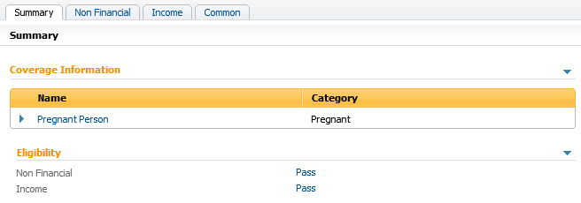
How to Fix a Rules Defect
First, look at the sample case listed in the defect to determine if it truly is a defect.
This screen does not match the design so the defect is valid.

Slide 85
How to Fix a Rules Defect (Cont.)
Next, try to recreate the defect in your local environment. Sometimes the defect is already fixed but hasn’t made its way to prod or the test environment.
If the steps to recreate are unclear, contact the tester who logged the defect.
After confirming the defect is valid, figure out where the issue: app level, IC level, PDC level.

Slide 86
How to Fix a Rules Defect (Cont.)
Run a session dump on the correct rules level.
Refer back to the session doc slides for where to start your debug.
For our example defect, we are looking at the display rules on the PDC.

Slide 87
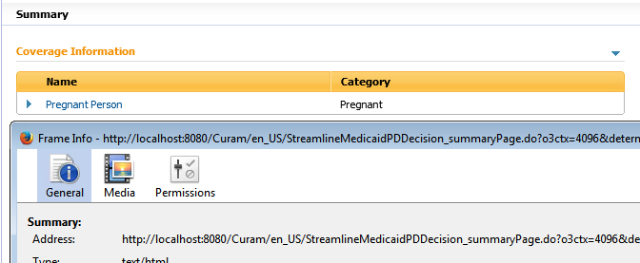
How to Fix a Rules Defect (Cont.)
After getting a session doc, we need to know where to look. We can find this from the .uim file.
Right click on the screen and get the page/frame info.

Slide 88
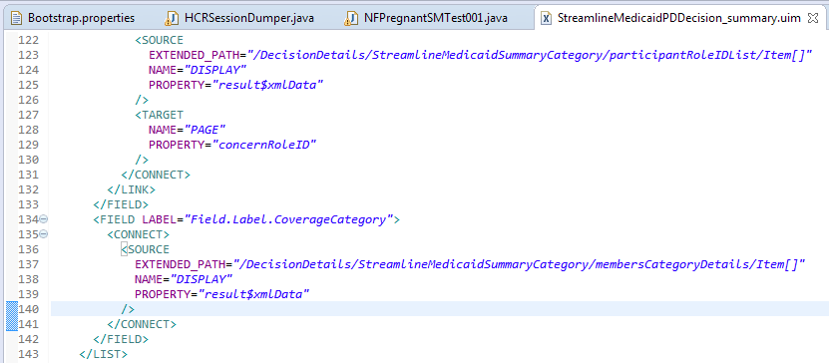
How to Fix a Rules Defect (Cont.)
Once you have the .uim name, search for it in Eclipse then find the specific field that is the issue.

Slide 89
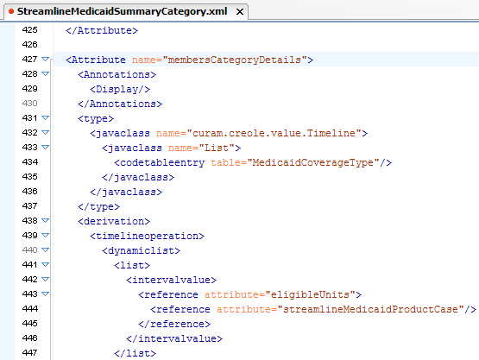
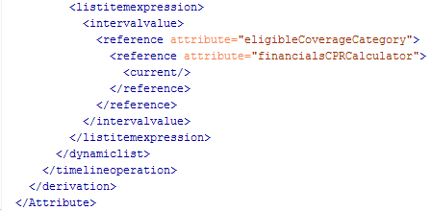
How to Fix a Rules Defect (Cont.)
Now that we have the xpath, we can follow the logic path in the session doc or in the rule file itself.

Slide 90
How to Fix a Rules Defect (Cont.)
From this, we know the display value comes from the eligibilityCoverageCategory attribute in the FinancialsCPRCalculator class in the StreamlineMedicaidEligibilityAndEntitlement rule set.

Slide 91
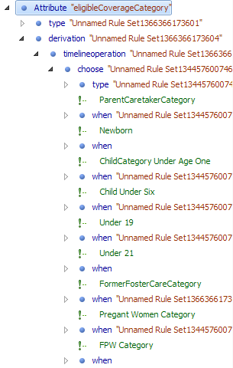
How to Fix a Rules Defect (Cont.)
Now we find the pregnancy logic within this attribute.

Slide 92

How to Fix a Rules Defect (Cont.)
In this <when>, we find the <value>.
In this example, the value is a codetable.
Note: in NCFAST we ignore internalID

Slide 93
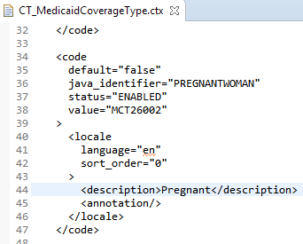
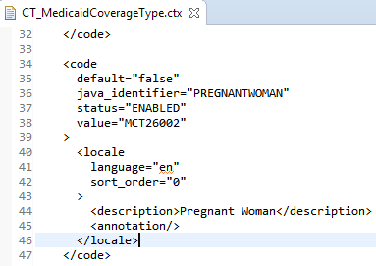
How to Fix a Rules Defect (Cont.)
Now, we go to the custom version of this codetable in eclipse and change the description.
Before
After

Slide 94
How to Fix a Rules Defect (Cont.)
Build commands for rules:
nfbuild implemented (when you change the return type, name, or args in a static file)
nfbuild creole.validate.rulesets (syntax check of your saved changes)
nfbuild creole.upload.rulesets (inserts your changes)
nfbuild database (when changing display rule uim/properties)

Slide 95

How to Fix a Rules Defect (Cont.)
You will need to run a rules reassessment after building the change to test the fix.

Slide 96
Helpful Links
In sharepoint:
CER Rule for new developers.docx
Display Rules and Creole DMX Files for new developers.docx

